Slide 1
System of
Success
Notes:
TRAINERS NOTES: Like with a franchise, we have a proven system for success. You don’t need to go through trial and error to make this work. All you have to do is understand the concepts and implement the system.

Slide 2
Market Singapore’s number one selling product is its UnFranchise® Business System
“System for entrepreneurs to create a significant ongoing income, while providing consumers with a better way to shop. ”
At the heart of this system is Market Singapore’s Management Performance Compensation Plan (MPCP) that rewards each UnFranchise® Owner (UFO) for changing what they shop for and how they shop for it.
Notes:
TRAINERS NOTES:
With the UnFranchise, anyone can build a residual income for themselves by implementing our proven plan.
There are many ways to build assets for yourself including: savings, stock, 4% returns, Whole-life insurance etc. With these types of investments, the return on investment is not guaranteed and the deal can change at any time. It is essentially a risk.
On the contrary, the MPCP allows you to build a strong asset where you know exactly what your ROI is based on the amount of BV and IBV your organization creates.
Transition into the next slide – Let’s take a closer look at other popular investments and how we compare.

Slide 3
Will you have this cash invested in the bank at today’s rates ?
UnFranchise® Ongoing Income | Equivalent Investment earning at 4%
S$1,875/ Month (Executive coordinator/ Master coordinator) | S$562,500
S$6,250 / Month (Professional coordinator) | S$2,000,000
S$12,500 / Month (National supervising) | S$4,000,000
S$22,500 / Month (Director) | S$7,312,500
S$45,000 / Month ( Field Vice President) | S$15,000,000
UnFranchise® Income vs. The 4% Rule Investment
Notes:
TRAINERS NOTES:
The 4% Rule is a popular investment-income strategy that says as long as you withdraw no more than 4% of your initial portfolio, adjusted for inflation, on an annual basis during your retirement years, you shouldn't run out of money.
Take a look at what it would take to create a S$1875 /month payment to yourself at retirement, following this rule. It would take S$562,500 in the bank! Would you have that money saved up by retirement?
Most Americans are living paycheck to paycheck with little to no savings. How will they get it done? The answer is that most won’t, and therefore will never have the 4% rule as a viable retirement option.
With Market America, you could create a S$1,875 / month asset as an executive coordinator or master coordinator. And even more, after 2-3 years of following our proven plan you could create a residual income of S$233,750 / year. That is the equivalent of living off of 4% of a S$6.25MILLION asset in the bank!
Think even further – if you built the UnFranchise as a way to enjoy residual income because you didn’t have the savings to participate in the 4% rule, now you can create the savings and earn both – the Residual Income from your UnFranchise and the 4% off the income you save!

Slide 4
Annuity Options Comparison
Ongoing monthly income S$1,875 options
Annuity/ Investments Options | Investments | Pros/ Cons
Fixed Deposit Interest (1.95%) | S$1,160,000 | Low risk low returns and high investment
Property rental (3.2%) | S$705,000 | Potential capital gains high and risky investment
Shares dividends (S$0.1782 per share) | S$400,050 | Potential capital gains investment may be volatile
CPF Life (Standard plan) | S$256,000 | Safe and very low risk can only take effect after 65 years old

Slide 5
Fixed Deposit interest
“Fixed deposit or time deposit accounts are investments that earn you interest over a fixed tenure. You don’t need to do anything to earn this interest, just park your money with a bank for a stipulated period, e.g. 6/12/24 months”
Investment = S$1,160,000
Interest = S$1,160,000 x 1.95%*
= S$22,620/ year
= S$1,885/ month
*https://www.sbising.com/TD_promotions

Slide 6
Shares dividend
“A sum of money paid regularly (typically annually) by a company to its shareholders out of its profits (or reserves)”
Investment = 127,000 shares @ S$3.15
= S$400,050
Dividend = 127,000 shares x S$0.1782*
= S$22,631.40/ year
= S$1,885.95/ month
*average of past 5yrs dividend of Singtel shares

Slide 7
Property Rental
“Buying a property and rent it out to earn a regular return, usually on a monthly basis”
Investment = S$705,000
Rent = S$705,000 x 3.2%*
= S$22,560/ year
= S$1,880/ month
*https://sg.finance.yahoo.com/news/singapore-high-yield-rental-properties-010000491.html

Slide 8
CPF Life
“The CPF is a mandatory social security savings scheme funded by contributions from employers and employees.
The CPF LIFE Scheme is a life annuity scheme that provides Singapore Citizens and Permanent Residents with a monthly payout for as long as they live.”
Amount in Retirement account = S$256,000*
Monthly payout = S$1,910 - S$2,060 monthly*
*Enhanced Retirement Sum
https://www.cpf.gov.sg/Members/Schemes/schemes/retirement/cpf-life#Item1596

Slide 9
What is an Annuity
An “Annuity” is a process by which a fixed payment is made to you at specified intervals for a specified length of time.
To fund the “Annuity” you must contribute a fixed sum payment before payouts to you may begin.
Notes:
TRAINERS NOTES:
Again, this is a popular investment and/or retirement strategy.
The benefit is that by paying into your annuity over time, you can expect to be paid back payments at retirement in monthly, quarterly, yearly or even lump sum payments based on your specific arrangements.
The downfall is that in order to fund the annuity, you need discretionary income to pay into it with. Most Americans have little to no discretionary income, therefore, cannot participate in an annuity program as part of their retirement strategy.

Slide 10
The Shopping Annuity® works the same way with one major difference: A UFO’s specified fixed sum payment is made not in legal tender, but in time & changed shopping habits.
You create your “fixed sum payment” by redirecting purchases you’re already making to SG.SHOP.COM to fund your Shopping Annuity®.
By performing the 4 Basic Steps in the Shopping Annuity® Handbook and ensuring all business partners within your two sales and distribution organisations duplicate these steps, you can reasonably expect to earn S$1,875 per week or more forever!
Notes:
TRAINERS NOTES:
The Shopping Annuity is not funded with discretionary income or “fixed sum payments’
The shopping annuity is funded by redirecting money you are already spending on monthly, seasonal and annual expenses to SG.SHOP.COM.
By changing how you shop and duplicating this in your organization, you fund your shopping annuity and build a residual income for yourself.
The hardest point to make here is that you are USING MONEY YOU’RE ALREADY SPENDING, rather than applying discretionary income.
RECURRING THEME – We This is the first time we hit it…. You fund your Shopping Annuity with money you are already spending by redirecting purchases to SHOP.COM. People MUST grasp this concept if we are going to get adaption. That adaption is critical for their success with the Shopping Annuity.

Slide 11
TRADITIONAL ANNUITY:
You must have discretionary income to make fixed sum payments which fund your annuity.
SHOPPING ANNUITY® : By redirecting money you are already spending to SG.SHOP.COM, you create your “fixed sum payment” to fund your Shopping Annuity®.
Notes:
TRAINERS NOTES:
This is a wrap up slide – a chance for you to summarize the key points side by side.

Slide 12
SHOPPING ANNUITY = ECONOMIC ALCHEMY
THE
THE
SG.SHOP.COM
REFERRAL
ADVANTAGE
TRACKING SYSTEM
Exclusive products
Other brands
Coupon codes
Promotions
Exclusive savings
Hot deals
Better products at better prices and a better way to shop.
Market Singapore can track and capture all your purchases from our stores, brands and merchants.
When you or anyone you lead to directly or indirectly, makes a purchase you get credit in the form of a social currency called BV and IBV.
That currency accumulates and when it reaches certain thresholds, you earn a residual income through the MPCP.
Notes:
TRAINERS NOTES:
This explains why the Shopping Annuity is dependable. It works because we have a better way to shop and the technology to track it.
We aren’t asking you to shop on a site that will cause you to spend more money.
Instead we are providing you a better way to shop with all deals, programs, technology. More than that we offer better products and pay you Cashback on all of your purchases.
The referral tracking system tracks all of your spending, the spending of your referred customers and your organizations’ spending. Those margins are reflected in a social currency called BV and IBV.
You are paid on that social currency via the MPCP
The end result is a better way to shop and a solid system to track and pay you

Slide 13
BECAUSE OF THE REFERRAL TRACKING SYSTEM, WE CAN LEVERAGE OUR COLLECTIVE BUYING POWER TO:
Convert margins into an ongoing income
Force prices down
Give increased BV and IBV, thereby, increasing YOUR RESIDUAL INCOME
IT’S AN IDEA
WHO’S TIME HAS COME
“With people power, the power of numbers, the referral tracking system, the MPCP, the SHOP.COM advantage… it’s time has come and it can’t be stopped.” – JR Ridinger, Chairman & CEO
Notes:
TRAINERS NOTES:
With technology today, we have the power to leverage our collective buying power!
We don’t need to solely have a consumer: retailer relationship anymore because we can recycle our money by converting the margins earned from shopping through our SHOP.COM website into an ongoing income.
Due to the massive numbers of UFOs and customers shopping through SHOP.COM, we have the power to force prices down and increase the margins that we get from those sales. That allows us to increase BV and IBV which increases your residual income and lessens the time it takes to achieve it.

Slide 14
Willable Asset
You can reasonably expect to earn S$1,875 - S$4,500 / week in perpetuity
You can will this asset to family and generations to come.
Notes:
TRAINERS NOTES:
How can you keep your hard earned assets in the family?
Your UnFranchise is a willable asset and can be willed to family and generations to come.

Slide 15
You’re Already Spending It…
Why Not Convert Your Spending Into Earning?
Notes:
TRAINERS NOTES:
Again, we are hitting this point! You are not funding this Shopping Annuity with discretionary income, but with money you are already spending.
Everybody spends money to live. You can either find a way to make that money work for you or you can continue to do what you’re doing and everything stays the same.

Slide 16
INCOME AND HOUSEHOLD STATISTICS
The following is from Department of Statistics Singapore, 2013 Household, singstat.gov.sg
S$126,000
S$117,100
S$56,694
AVERAGE CONSUMER UNIT CHARACTERISTICS:
Income
Before tax
Income
AFTER TAX
Total Average Annual Expenditures
Average number in consumer unit:
People
Children
Adults 65 and older
Earners
Vehicles
Men
Women
3.3
0.6
0.4
1.9
0.7
49%
51%
Notes:
TRAINERS NOTES:
We’ve been saying that people are spending the money. All they need to do is convert it.
Now we are going to introduce statistical evidence which proves the point that the money IS being spent. One of the biggest mental/ thinking hurdles we need to overcome when presenting this is the idea that the money is being spent. Many people make their money and spend all (or almost all of it) yet still have a knee-jerk reaction and think they couldn’t find the dollars from their current spending to transfer over. The purpose of this upcoming section is to eliminate those concerns by showing hard data.
Don’t forget to note:
These stats are not UnFranchise Stats.
Sources:
Average and Median Monthly Household Income
https://www.singstat.gov.sg/-/media/files/publications/households/hes1213.pdf
Average Monthly Household Expenditure by Type of Goods and Services (Detailed) and Income Quintile ^{1/} 2012 / 13 http://www.tablebuilder.singstat.gov.sg/publicfacing/createSpecialTable.action?refId=6745
Average number in consumer unit ( households in Singapore 1,289,900) http://www.tablebuilder.singstat.gov.sg/publicfacing/createSpecialTable.action?refId=15452

Slide 17
Apparels S$1,872
Recreation S$5,256
Communication S$2,592
House, Utilities, Furnishing, Maintenance, Grocery
S$13,332
Dining S$9,168
Education S$3,720
WHERE DOES THE MONEY GO?
Health Care S$6,660
Miscellaneous S$6,924
Transportation S$9,732
Notes:
Sources:
http://www.tablebuilder.singstat.gov.sg/publicfacing/createSpecialTable.action?refId=6745

Slide 18
Apparels S$1,872
Recreation S$5,256
Communication S$2,592
House, Utilities, Furnishing, Maintenance, Grocery
S$13,332
S$59,256
could be redirected to SHOP
Dining S$9,168
Education S$3,720
WHERE DOES THE MONEY GO?
Health Care S$6,660
Miscellaneous S$6,924
Transportation S$9,732

Slide 19
HOW DOES YOUR MONTHLY SPENDING COMPARE TO THE AVERAGE MONTHLY SPENDING?
Dining
Personal Care
Product & Service
Communication
Recreation &
Holiday
Education
Healthcare & Insurance
Housing, Utilities, Furnishing, Maintenance & Grocery
Transportation
Miscellaneous &
Personal Care
S$59,256
S$4,938
ANNUAL TOTAL
MONTHLY TOTAL
Notes:
TRAINERS NOTES:
There are little pockets of spending everywhere that could be transferred to your Shopping Annuity. You just have to be aware of where your money is going and make a conscious decision to transfer it.
Your business is currently LEAKING MONEY everywhere. You have the opportunity to take all of this money, which statistically you are going to spend anyway and turn that spending into a residual income for yourself.
Ask yourself, how much are you missing out on? If your team is only doing 10% of their shopping on their SHOP.COM website, it’s like taking a pallet of thousands of dollars and just setting it on fire. Money wasted!
Don’t waste or underestimate the power of your current spending. Put that money to work for you and use it to build your Shopping Annuity.

Slide 20
Exclusive
Brands
Better PRODUCTS
Better Prices
Cashback!
Start identifying which of the company’s exclusive brands you could use instead of other brands to fund your Shopping Annuity$®$.
Notes:
TRAINERS NOTES:
Best of all, we aren’t asking you to sacrifice quality or price. Our exclusive brands are superior products, with better prices than the competition and we pay you Cashback for purchasing them.
Not to mention, by choosing these superior products, you are funding your Shopping Annuity

Slide 21
™
Notes:
TRAINERS NOTES:
It’s not just about our exclusive brands, we provide a better way to shop.
This is a transitional slide that will highlight some of the most exciting parts of SG.SHOP.COM

Slide 22
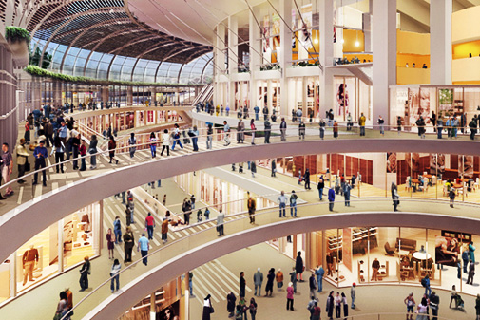
Brick and Mortar
Click and Order
to
Notes:
TRAINERS NOTES:
You have to be aware of the money you would “leak” in the stores and switch it to SHOP.COM
If you are already an online shopper, you have to shift your spending behaviors to go through SHOP.COM first or simply install and login to ShopBuddy to make sure you are funding your Shopping Annuity.

Slide 23
Welcome to shopping mall B1
Supermarket

Slide 24
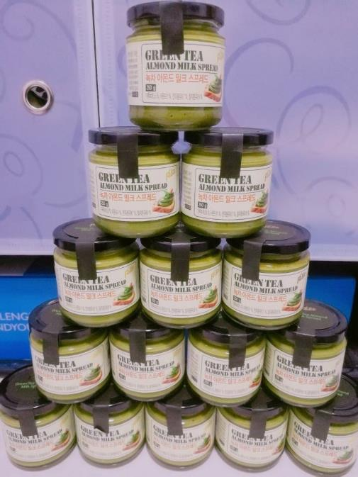
Price: S$13.90
Cashback 3%: S$0.42
IBV 2% : 0.20 IBV

Slide 25
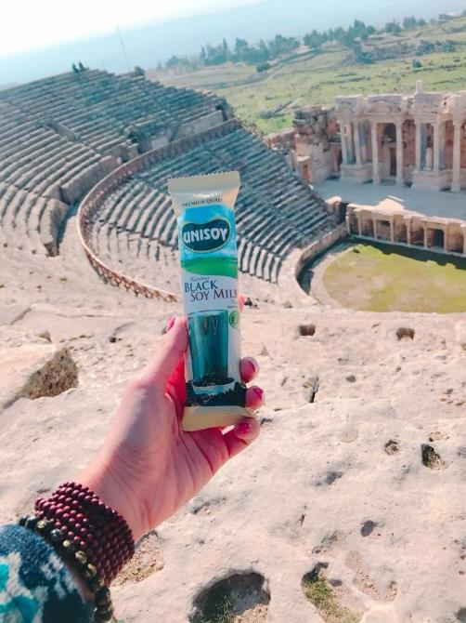
Price: S$8.90
Cashback 2%: S$0.17
IBV 2% : 0.13 IBV

Slide 26
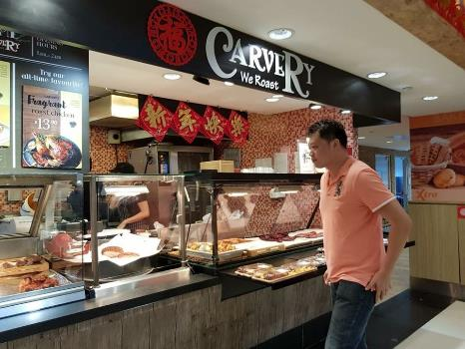
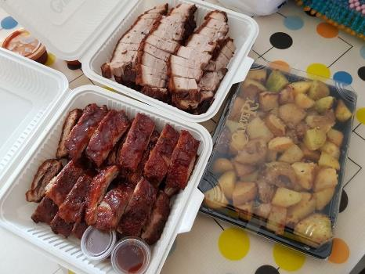
Price: S$8.25
Cashback 5%: S$0.41
IBV 3% : 0.18 IBV

Slide 27
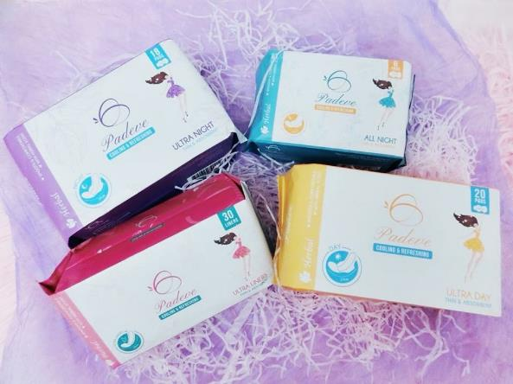
Price: S$20
Cashback 5% : S$0.4-
IBV 3% : 0.44 IBV

Slide 28
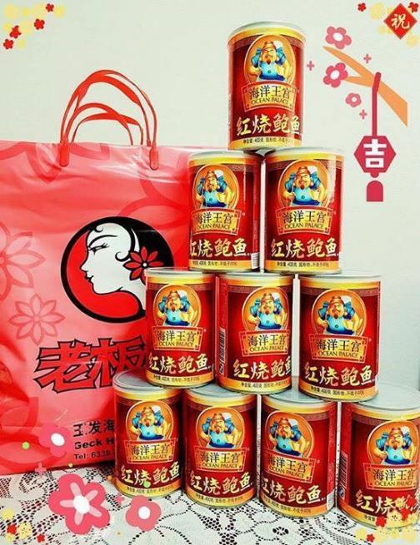
Price: S$25
Cashback 2%: S$0.50
IBV 3% : 0.55 IBV

Slide 29
Welcome to shopping mall 1F
Cosmetics

Slide 33
Welcome to shopping mall 2F
Women’s Fashion

Slide 34
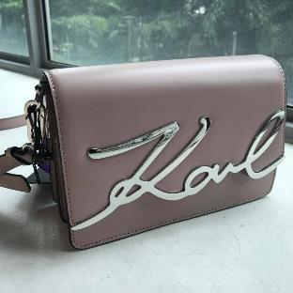
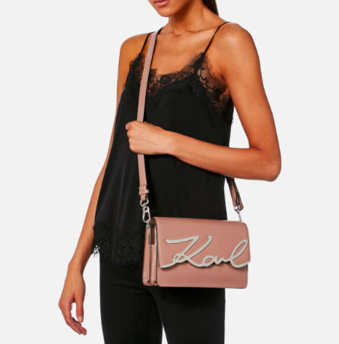
Brand:
Price: S$363 (Euro 226.8)
Cashback 4%: S$14.52
IBV 2%: 5.34 IBV

Slide 35
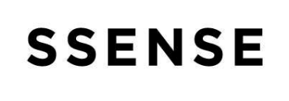
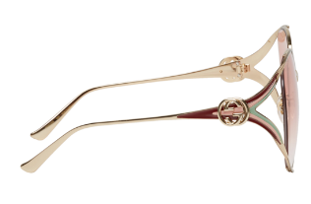
Brand:
Price: S$554 (CAD 585)
Cashback 2%: S$11.08
IBV 2%: 8.15 IBV

Slide 36
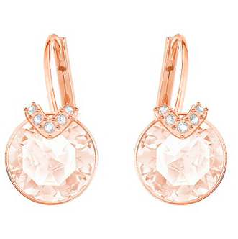
Brand:
Price: S$99
IBV 2%: 1.46 IBV

Slide 37
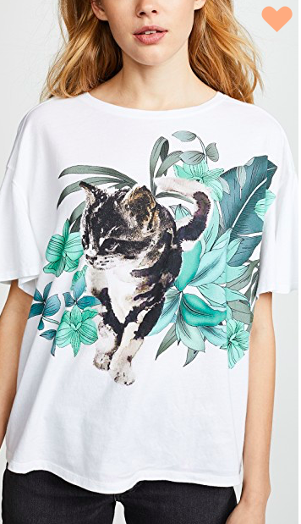
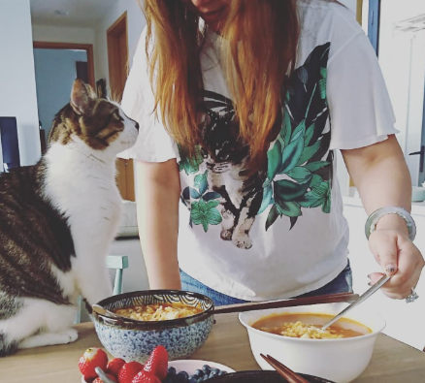
Brand:
Price: S$99 (USD 72.5)
IBV 1%: 0.725 IBV

Slide 38
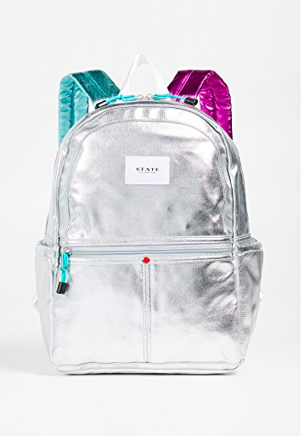
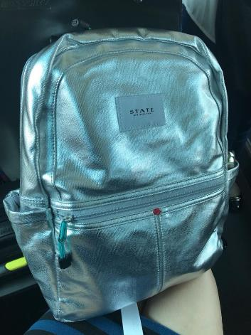
Bramd:
Price: S$109 (USD80)
IBV 1%: 0.8 IBV

Slide 39
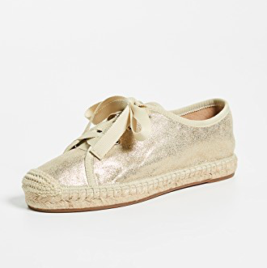
Brand:
Price: S$54 (USD 32.4)
IBV 1%: 0.324 IBV

Slide 40
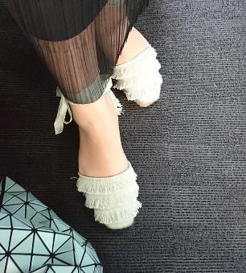
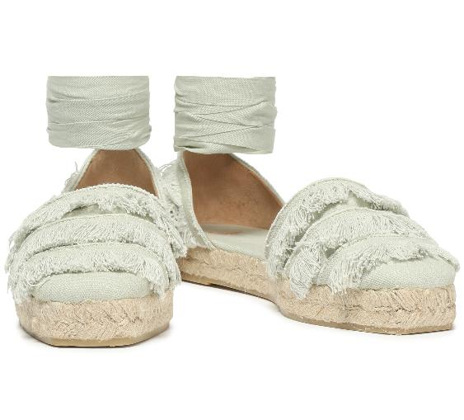
Brand:
Price: S$101 (USD 74)
Cashback 3%: S$3.03
IBV 2%: 1.48 IBV

Slide 41
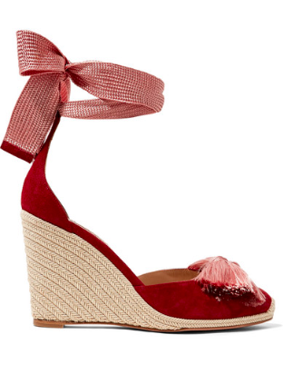
Brand:
Price: S$386 (USD 231)
IBV 3%: 6.93 IBV

Slide 42
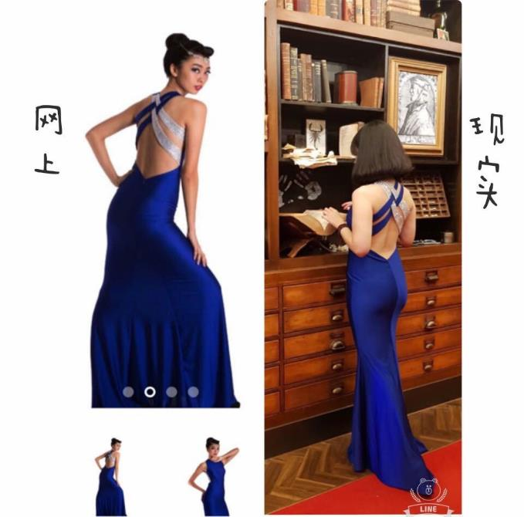
Price: S$82
Cashback 5%: S$4.10
IBV 3%: 1.81 IBV

Slide 43
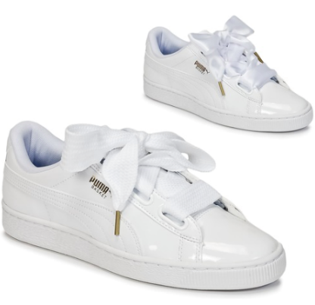
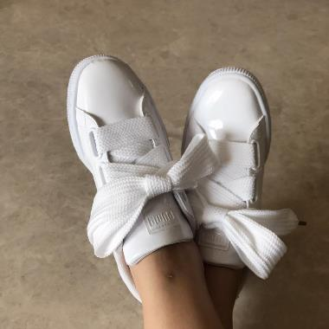
Brand:
Price: S$125.94
Cashback 2%: S$2.52
IBV 2%: 1.85 IBV

Slide 44
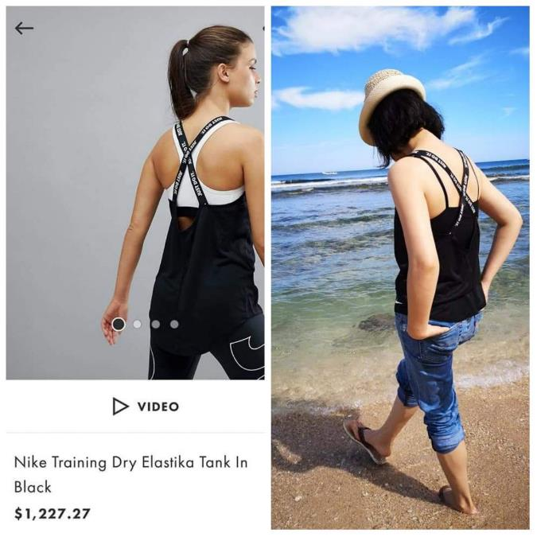
Brand:
Price: S$55
Cashback 2%: S$1.10
IBV 2%: 0.81 IBV

Slide 45
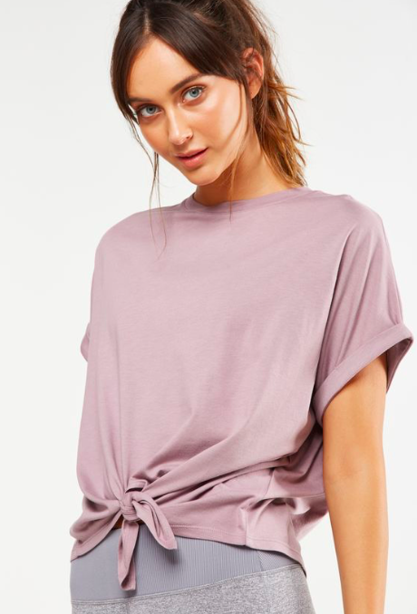
Price: S$24.95
Cashback 4%: S$0.998
IBV 2%: 0.37 IBV

Slide 46
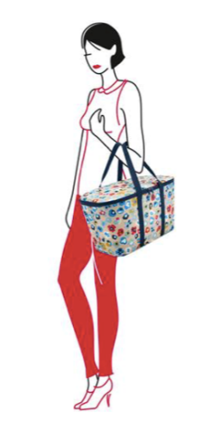
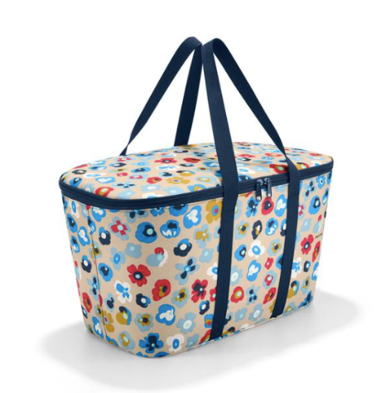
Price: S$59
Cashback 3%: S$1.77
IBV 1.5%: 0.65 IBV

Slide 47
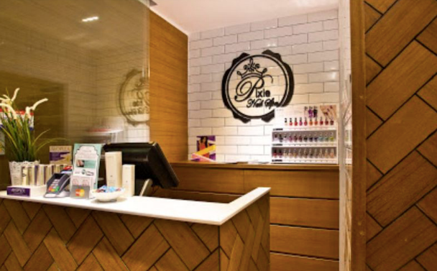
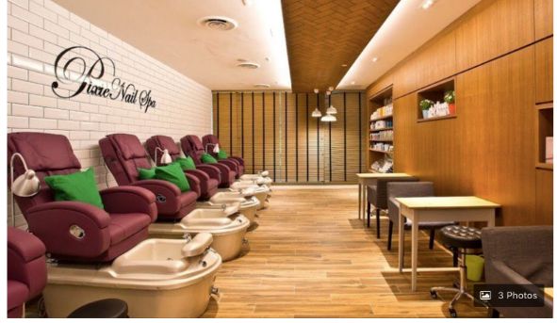
Gel Manicure with Return Soak-Off
+ Classic / Gel Pedicure
Price: S$30
IBV 3%: 0.66 IBV

Slide 48
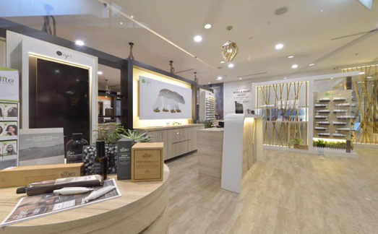
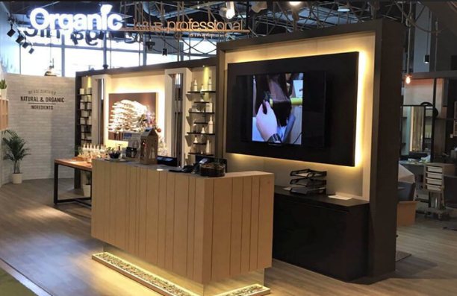
Organic Hair Colouring or Highlight + Argan Oil Treatment
Price: S$58
IBV 3%: 1.28 IBV

Slide 49
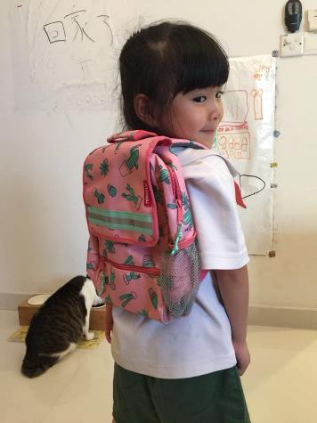
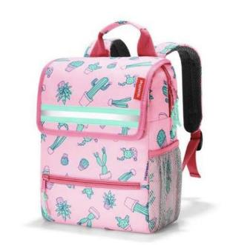
Price: S$66
Cashback 3%: S$1.98
IBV 1.5%: 0.73 IBV

Slide 50
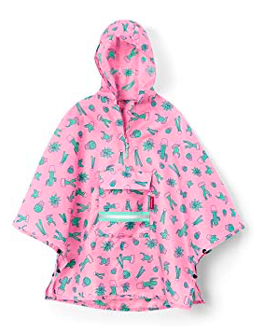
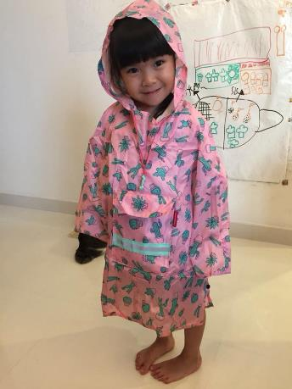
Price: S$49
Cashback 3%: S$1.47
IBV 1.5%: 0.54 IBV

Slide 51
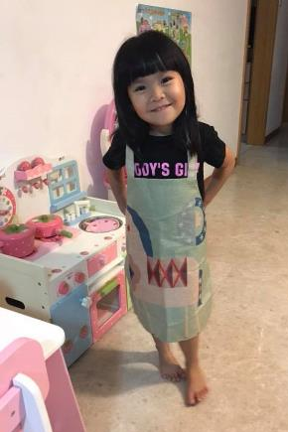
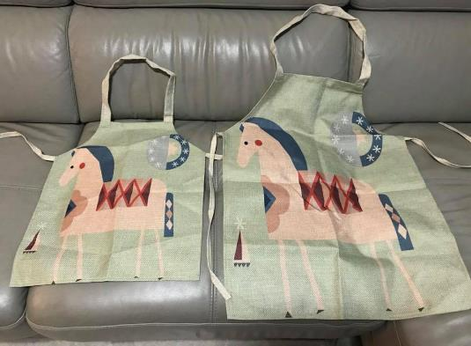
Price: S$24.45
Cashback 6%: S$1.46
IBV 4% : 0.72 IBV

Slide 52
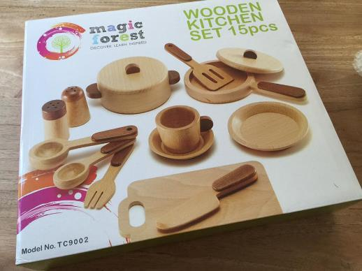
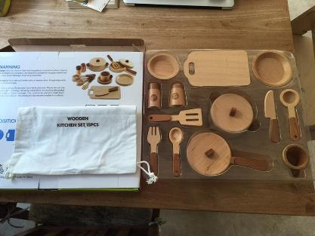
Price: S$69.90
Cashback 15%: S$10.48
IBV 13% : 6.68 IBV

Slide 53
Welcome to shopping mall 3F
Men’s Fashion

Slide 54
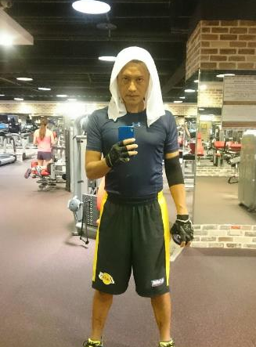
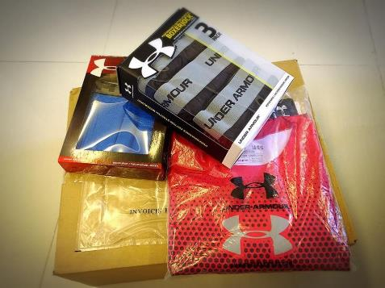
Price: S$130.75
Cashback 2%: S$2.61 IBV 2%: 1.38 IBV

Slide 55
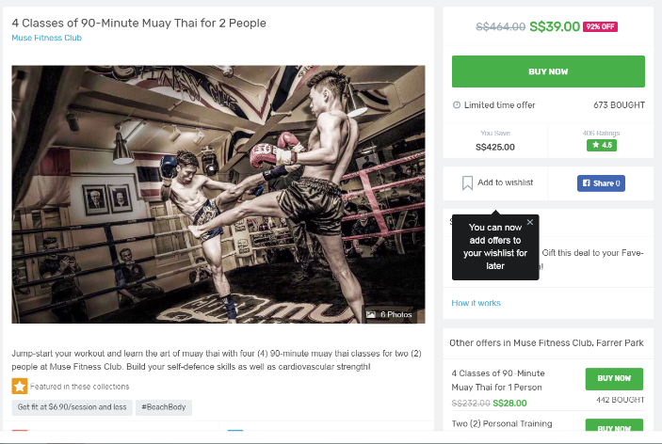
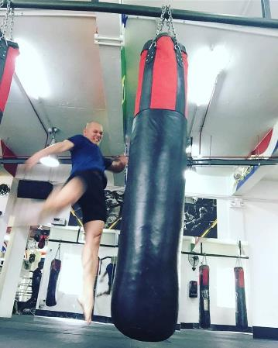
Price: S$39
IBV 3%: 0.86 IBV

Slide 56
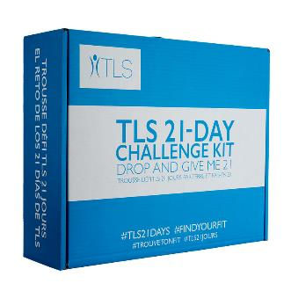
TLS 21 Day Challenge Kit
Price: S$323.25
Cashback 2%: S$6.04 BV: 70 BV

Slide 57
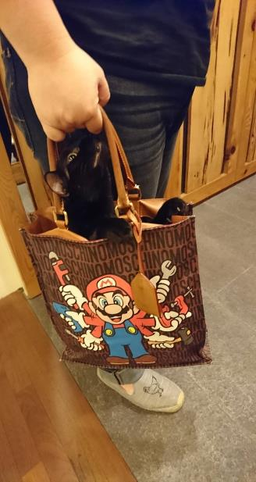
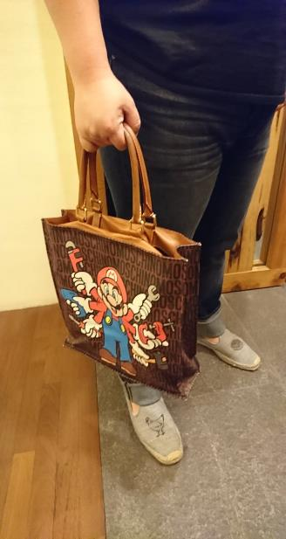
Price: S$347.82
IBV 1.0%: 2.54 IBV

Slide 58
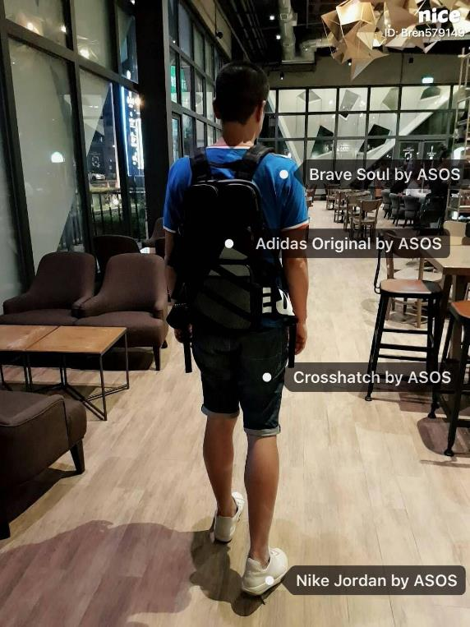
Price: S$97.98
Cashback 2%: S$1.96 IBV 3%: 2.15 IBV

Slide 59
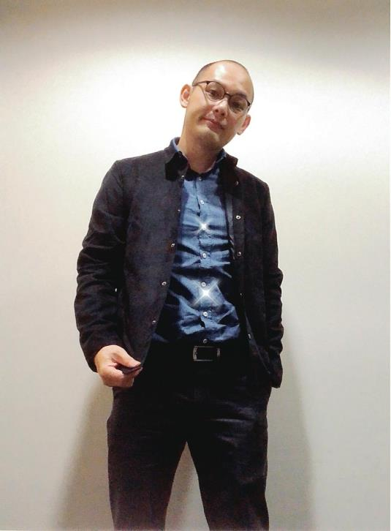
Price: S$98.80
IBV 2%: 2.17 IBV

Slide 60
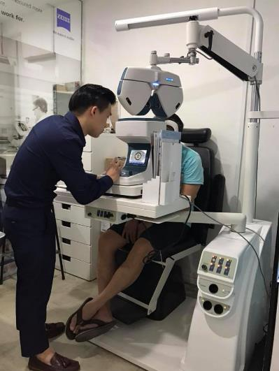
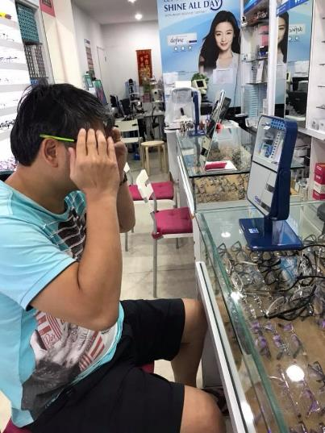
Price: S$650
Cashback 9%: S$58.50 IBV 6%: 26.32 IBV

Slide 61
Welcome to shopping mall 4F
Children’s Clothes and Toys

Slide 62
Birthday Gift
Up to 4 % Cashback
Up to 2 % IBV
Price : S$36.90
IBV 2 %, 0.54 IBV

Slide 63
Birthday Gift
Up to 4 % Cashback
Up to 2 % IBV
Price : S$13.30
IBV 2%, 0.19 IBV

Slide 64
Up to 2 % Cashback
Up to 2 % IBV
Toys
Original: S$15.90
Price: S$14.31 (member)
Cashback 2%: S$0.29
IBV 2%: 0.21 IBV

Slide 65
Comic Books
Up to 2 % Cashback
Up to 2 % IBV
Original : S$50.13
Price : S$45.09 (member)
Cashback : S$0.90
IBV 2%: 0.66 IBV

Slide 66
Indoor Playground
Up to 3.0% IBV
Original : S$28.00
Price : S$25.25
Promo Code (Fave) : S$2.75
IBV 3%: 0.55 IBV

Slide 67
Indoor Playground
Up to 3.0% IBV
Original : S$40.00
Price : S$30.00
Promo Code : S$10.00
IBV 3%: 0.66 IBV

Slide 68
DNA Miracles™ Chewable Probiotics
Price : S$54.25 Cashback : S$1.01
17.0 BV

Slide 69
DNA Miracles™ Natural 3-Piece Value Kit
Price : S$68.00 Cashback : S$1.27
15.0 BV

Slide 70
Welcome to shopping mall 5F
Furniture & Electronics

Slide 71
Brendenn Beh
Executive Coordinator
Audit Background
MUFO 6 times
SA Master Member

Slide 72
Price: S$228.40
IBV 1% : 1.63 IBV

Slide 73
Price: S$2,895.32 (2 pcs)
Cashback 4%: S$115.81
IBV 2% : 41.36 IBV

Slide 74
Price: S$200.00
IBV 1% : 1.43 IBV

Slide 75
Price: S$100.00+
IBV 1% : 0.71 IBV

Slide 76
Cashback 2%
IBV 2%

Slide 77
Price: S$309.99
IBV 1% : 2.25 IBV

Slide 78
Price: S$20.00
Cashback: S$0.37
BV：6 BV

Slide 79
Price: S$23.50
Cashback: S$0.44
BV : 5 BV

Slide 80
Price: S$143.00
BV : 25 BV

Slide 81
Welcome to shopping mall 6F
Travel and Vacations

Slide 82
Price : S$300
Cashback 3% : S$9
IBV 2%

Slide 83
Price : S$200
Cashback 4% : S$8
IBV 2%

Slide 84
Price : S$380
Cashback 4% (Conditions apply)
IBV 2%

Slide 85
Price : S$46
Cashback 2% : $0.92
IBV 2%

Slide 86
Price : S$ 249.85
Cashback 4% : S$9.99
IBV 2%
The North Face Cobra 60L Backpack

Slide 87
Price : S$25
IBV 3%

Slide 88
Price : S$90
Cashback 2% : S$1.80
IBV 2%

Slide 89
Isotonix®
Daily Essentials Kit
Price : S$285.25
Cashback : S$5.33
BV: 88 BV

Slide 90
Cellular Laboratories®
De-Aging Sunscreen Broad Spectrum SPF 50+
Price : S$68
Cashback : S$1.27
BV: 24 BV

Slide 91
TLS™
Trim Tea
Price : S$64.75
Cashback : S$1.21
BV 20 BV

Slide 92
Welcome to shopping mall 7F
Food Court & Beverages

Slide 93
Walk In
Price: S$16.90
Cashback 3%: S$0.50 IBV 1.5%: 0.19 IBV

Slide 94
Walk In
Total Price: S$149
Shop.com card: S$50 Fave: S$99 (for S$200 voucher)
Cashback 2%: $S1.00 Walk-In IBV 2%
+ Fave IBV 3%: 2.91 IBV

Slide 95
Walk In
Price: S$48 onwards
Cashback 5%: S$2.40
IBV 3%: 1.05 IBV

Slide 96
Price: S$24.00 onwards
Cashback 4%: S$0.96 IBV 2%: 0.35 IBV

Slide 97
Price: S$75.00
Cashback 5%: S$3.75 IBV 3%: 1.65 IBV

Slide 98
Price: S$12.00
IBV 3%: 0.26 IBV

Slide 99
Price: S$17.80
IBV 3%: 0.39 IBV
4-Tier Pagoda Hotpot and BBQ buffet

Slide 100
Price: S$16.90
IBV 3%: 0.37 IBV
Mookata Dinner Buffet

Slide 101
Price: S$12.60
IBV 3%: 0.28 IBV
Lao Ban Soya Beancurd (Herbal Jelly x 4 + Beancurd x 4)

Slide 102
Price: S$38.80 for 2 pax
IBV 3%: 0.85 IBV
M Hotel Tea Bar Afternoon Tea Set

Slide 103
Price: S$12.90 for 2 pax
IBV 3%: 0.28 IBV

Slide 104
Price: S$13.00
IBV 2%: 0.19 IBV
Signature Main + Beverage + Dessert

Slide 105
Price: S$56.00
Cashback: S$1.05 BV: 18 BV
Price: S$79.25
Cashback: S$1.48 BV: 28 BV

Slide 106
Price: S$89.25
Cashback: S$1.67 BV: 30 BV

Slide 107
Welcome to shopping mall 8F
Theater and Bookstore

Slide 108
Price: S$39.60
Cashback 2%: S$0.79
IBV 2% : 0.46 IBV

Slide 109
Price: S$10.82
Cashback 2%: S$0.22
IBV 2% : 0.16 IBV

Slide 110
Original Price: S$13.00
Discount Price: S$10.99
IBV 3% : 0.24 IBV

Slide 111
Original Price: S$24
Discount Price: S$13
IBV 3% : 0.29 IBV

Slide 112
Original Price: S$1,299
Discount Price: S$399
IBV 3% : 8.8 IBV

Slide 113
Original Price: S$76
Discount Price: S$72
IBV 2% : 1.06 IBV

Slide 114
Create your “Fixed Sum” Payment using your current spending to create a residual income for yourself
Save Money
The Shopping Annuity® Creates
Economic Synergy
Earn Money
Duplicate the process with your organisation & customers to accelerate and increase residual income!
Notes:
TRAINERS NOTES:
This is another slide to bring the big point Home!
It’s a summary slide that shows the power of the Shopping Annuity
This is a transition to illustrate exactly why it works and how it works

Slide 115
A Forced Multiplier for Stronger Results
The Shopping Annuity® acts as a forced multiplier to accelerate a residual income generated by the MPCP.
New UFOs will earn commissions and achieve new UnFranchise™ Levels faster by leveraging the Shopping Annuity®.
Current UFOs earning commissions can increase their income 50% to 100% from their existing business.
The Shopping Annuity® takes 75% fewer people to earn the same amount of commissions.
The Shopping Annuity® is rocket fuel for the MPCP, helping you and your team generate a residual income of S$234,000 per year.
Notes:
TRAINERS NOTES:
Explain these five points. The idea is that the shopping annuity is rocket fuel for the MPCP. It causes a forced multiplier for the business. Takes fewer people and creates larger incomes.
TRANSITION – Let me show you exactly how this works -

Slide 116
ORGANISATION SATISFYING THE MINIMUM ACTIVITY REQUIREMENTS
S$750 each month (BV) & S$375 every third month (IBV)
50 x 50 BV = 2,500 BV
50 x 10 IBV = 500 IBV
50 x 50 BV = 2,500 BV
50 x 10 IBV = 500 IBV
Notes:
TRAINERS NOTES:
This is an organization of 50 people on the left and 50 people on the right
Everyone is doing the minimum activity requirements / not participating in the Shopping Annuity
The multiplier is small because noone is really doing the business and definitely not doing the shopping annuity , therefore only creating $750 per month in BV checks and $375 every 3 months in IBV commissions.

Slide 117
ORGANISATION SATISFYING THE MINIMUM ACTIVITY REQUIREMENTS
S$9,375 each month (BV) & S$3,750 every month (IBV)
50 x 500 BV = 25,000BV
50 x 200 IBV = 10,000 IBV
50 x 500 BV = 25,000 BV
50 x 200 IBV = 10,000 IBV
Notes:
TRAINERS NOTES:
Look at the incredible difference when you take that exact same organization and have everyone doing the Shopping Annuity
The SA is the forced multiplier!
With everyone committing to the Shopping Annuity, that same organization is creating a way more substantial income for your business… $7,500/month in BV commissions and $3,000/month in IBV Commissions.

Slide 118
The Shopping Annuity® takes 75% fewer people to earn the same amount of commissions!
Notes:
TRAINERS NOTES:
Because of the forced multiplier, you earn a substantial income and only need to build a business with 25% of the partners.
Think about it, you could build a “business’ of people doing the minimums with 50 on the left and 50 on the right to create $600/month OR
You could build your business to $600/month with 5 on your left and and 5 on your right
The Shopping Annuity = Rocket Fuel for the MPCP! It gets you there faster, with fewer people and everyone is successful sooner!

Slide 119
THE SHOPPING ANNUITY® FUNDING PLAN
Notes:
TRAINERS NOTES:
Now that you agree, let’s go through the Shopping Annuity Funding Plan
This is a transitional slide that is going into the 4 steps.

Slide 120
FOUR STEPS To BUILD A SHOPPING ANNUITY®
1.
Take the Shopping Annuity Assessment
2.
Change your Shopping Habits
3.
Automate your Shopping Annuity
Create Leverage
4.

Slide 121
Complete the
Shopping Annuity® assessment
Download at: www.shoppingannuity.com
The Shopping Annuity® Assessment will:
Identify the products you could replace with the company’s exclusive brands.
Calculate the BV and Cashback Potential
Notes:
TRAINERS NOTES:
We offer hundreds of exclusive products and we know that you probably only use or are even aware of a handful of them. That is why we created the Shopping Annuity Assessment Handbook and Workbook.
You can download the handbook and workbook at Shoppingannuity.com
From there, you can complete exercise 2
You enter in your household size: number of adult females, males, children, pets and cars
Take 15 minutes to go through a put an “x” next to each of our exclusive brands that you might use
Click “Calculate my Shopping Annuity Potential” and it will tell you the potential monthly and quarterly BV that you could be earning to fund your Shopping Annuity.

Slide 122
Exercise 3: Regular Monthly Spending | Avg. Monthly Consumer Spending* |  | My Monthly Spending
Food
Cereals and bakery products | $45 |  | $10
Cereals and cereal products | $15 |  | $0
Bakery products | $30 |  | $10
Meats, poultry, fish, and eggs | $71 |  | $63
Beef | $18 |  | $20
Pork | $14 |  | $12
Poultry | $14 |  | $20
Fish and seafood | $10 |  | $10
Processed fruits | $10 |  | $10
Processed vegetables | $11 |  | $11
Other food at home | $118 |  | $100
Food away from home | $219 |  | $200
Alcoholic beverages | $37 |  | $40
Housing |  |  | $283
Maintenance, repairs, insurance, other expenses | $99 |  | $99
Residential phone service, VOIP, and phone cards | $30 |  | $30
Cellular phone service | $76 |  | $76
Other household expenses | $65 |  | $65
Laundry and cleaning supplies | $13 |  | $13
Other household products | $29
Household textiles | $8
Furniture | $32
Floor coverings | $2
Major appliances | $18
Small appliances, miscellaneous housewares | $8
Miscellaneous household equipment | $61
Apparel and services | $134
Transportation/Maintenance and repairs | $70
Healthcare |  |  | $0
Drugs | $39
Medical supplies | $11
Entertainment | $207 |  | $0
Fees and admissions | $47
Audio and visual equipment and services | $80
Pets, toys, hobbies, and playground equipment | $50
Other entertainment supplies, equipment, and services | $29
Personal care products and services | $51
Reading | $9
Miscellaneous
other expenses (avg calculated 30% of total) | $54
Totals | $1,580 |  | $396
Exercise 4: Seasonal Spending
 |  | My Monthly Seasonal Spending:
 | Q1: January / February / March
 | New Years:
 | Chinese New Years:
 | Three Kings Day:
 | Valentine’s Day
 | Super Bowl:
 | World Conference
 | Mardi Gras:
 | St.Patrick’s Day:
 | Winter Clothes
 | Birthdays:
 | Anniversaries:
 | Other:
 | Q2: April/ May / June
 | Passover:
 | Palm Sunday:
 | Easter:
 | Administrative Professionals Day:
 | Cinco De Mayo:
 | Mothers Day:
 | Memorial Day:
 | Fathers Day:
 | Spring Appliances / Furniture / Décor
 | Spring Clothing
 | Birthdays:
 | Anniversaries:
 | Other:
 | Q3: July / August / September
 | Independence Day:
 | International Convention:
 | Vacation:
 | Labor Day:
 | Back to School:
 | Rosh Hashanah:
 | Summer Clothes
 | Birthdays:
 | Anniversaries:
 | Other:
 | Q4: October / November / December:
 | Yom Kippur
 | Boss’s Day:
 | Halloween:
 | Veteran’s Day
 | Thanksgiving
 | Black Friday
 | Cyber Monday
 | Chanukah
 | Christmas
 | New Year’s Eve
 | Fall Clothes
 | Fall Décor
 | Birthdays:
 | Anniversaries:
 | Other:
 | Annual Spending:
 | Electronics: | $600
 | Appliance: | $1,200
 | Other:
 | Total Seasonal Spending: | $1,800
Complete the
Shopping Annuity® assessment
Download at www.shoppingannuity.com
The Shopping Annuity® Assessment will help you identify:
Your regular monthly spending
Your annual spending triggered by events, occasions and special purchases. (i.e: Mother’s Day, birthdays, anniversaries etc.)
How you can change your habits to shopping through your SG.SHOP.COM website to fund your Shopping Annuity®.
Notes:
TRAINERS NOTES:
In that same Shopping Annuity Assessment Workbook and Handbook, you will complete exercise 3 and 4 to identify all of your monthly, seasonal and annual spending that you do. It’s important to have the shopper of the household present when completing these exercises to have the most accurate results and to get the best adaption.
In exercise 2:
You will see all of those categories of monthly spending that could be transferred to SHOP.COM
To the right, you will be reminded of the average monthly spend on that item
To the right of that reminder, you can enter in what YOU spend monthly on each given item
How does your monthly spending compare?
In exercise 4, we prompt you to think about all of the other items you buy throughout the year. We organized it by quarter to help focus your thinking so you could identify every area that your business may be leaking potential BV and IBV!
In the Shopping Annuity Assessment Handbook, we included a list for your reference with our most reliable partner stores, organized by category. This will give you a nice starting point for where to buy the items you identified in these two exercises.

Slide 123
4
Create Leverage
Identify individuals committed to improving their financial situation by performing Steps 1-4.
Complete the Shopping Annuity® Assessment with Business Partners and Prospects
Work together to change shopping habits and create massive BV & IBV.

Slide 124
Identify 10-15 individuals and build relationships to create lifetime value in customers or future business partners (UFOs).
Customers get paid Cashback for purchasing the company’s exclusive brands.
Customers get paid Cashback for purchasing from our partner stores through SG.SHOP.COM/yoursite.
Create BV & IBV with
Customers
Customers get paid cashback for referring Customers to SG.SHOP.COM/yoursite to do the same.
Notes:
TRAINERS NOTES:
Don’t forget to build share of customer! You can create additional BV and IBV by creating lifetime value with your customers.

Slide 125
Your Shopping Annuity® at Maturity
Spending and Earning Projections
 | 1 YR | 3 YR | 5 YR | 10 YR
Projected Spending | S$16,137 | S$48,413 | S$80,690 | S$161,378
Current Earning | S$27,000 | S$81,000 | S$135,000 | S$270,000
Projected Earning | S$49,500 | S$148,500 | S$247,500 | S$495,000
% Increase | 83% | 83% | 83% | 83%
Earning Minus Spending | S$33,362 | S$100,086 | S$166,810 | S$333,621
The result of completing the four steps is a matured Shopping Annuity® that will continue to generate an ongoing income.
You are Converting Your Spending into Earning
You are funding your Shopping Annuity® with money you’re already spending
Notes:
TRAINERS NOTES:
Once you’ve completed the four steps and are funding your shopping annuity, your shopping annuity will mature over time.
Take a look at the increased income for those who those who build their shopping annuity.
You were earning S$27,000 in year 1. With the shopping annuity, your projected earning increases to $49,500!

